Slide 1

From Signals to Sensing: MatID a Deep Learning Approach to WiFi-Based Material Identification
Master in Artificial Intelligence and Robotics
Cristiano Bellucci 1760390
Supervisors
Danilo Avola
Daniele Pannone
Academic Year 2023/24
Notes:
Good morning/afternoon/evening everyone,
Today, I'm delighted to have the opportunity to present my internship report, which focuses on an incredibly fascinating field of study: Electroencephalography, or EEG for short specifically I worked on the denoised of the aforementioned waves.

Slide 2


Table Of Contents
Context
Objectives
SOTA
Proposed Solution
Results
Conclusions
Notes:
Through my presentation, I aim to provide you with a comprehensive overview of the project, highlighting its context, objectives, previous approaches, the methodology employed, and finally, the conclusions drawn from my research.

Slide 3
Context ●○
WiFi and WiFi Sensing
Provides wireless connectivity for multiple devices, enhancing mobility and convenience
Facilitates communication and resource sharing in homes, schools, and businesses
Enables smartphones, tablets, and laptops to connect to the internet and each other
WiFi Sensing uses WiFi signals to sense and interpret the surrounding environment, including objects and people
Notes:
Before delving into the specifics of my internship experience, I'd like to take a moment to provide you with an overview of what EEG entails and why it's such a crucial area of research. EEG is a non-invasive technique that measures the electrical activity of the brain using electrodes placed on the scalp. By capturing these brainwave patterns, EEG enables us to gain insights into the functioning of the human brain, understand cognitive processes, and investigate various neurological conditions.
This technology is therefore used not only for a huge variety of medical investigations but is also gaining more space in commercial applications.

Slide 4

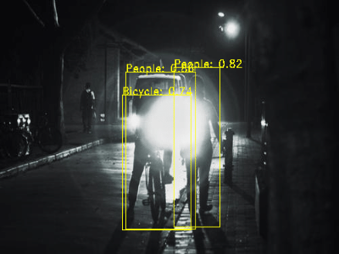


Context ○●
Limitations of Traditional Methods
Visual and other traditional methods are often hindered by environmental factors like lighting, obstructions and low visibility
Advanced visual-based systems and other traditional methods require sophisticated and expensive equipment
Traditional methods often require invasive techniques or visual data, raising privacy issues
Notes:
Before delving into the specifics of my internship experience, I'd like to take a moment to provide you with an overview of what EEG entails and why it's such a crucial area of research. EEG is a non-invasive technique that measures the electrical activity of the brain using electrodes placed on the scalp. By capturing these brainwave patterns, EEG enables us to gain insights into the functioning of the human brain, understand cognitive processes, and investigate various neurological conditions.
This technology is therefore used not only for a huge variety of medical investigations but is also gaining more space in commercial applications.

Slide 5
Table Of Contents
Context
Objectives
SOTA
Proposed Solution
Results
Conclusions
Notes:
Moving on to the core topic of the internship, I’d like to give an insight of what are the Objective of this study.

Slide 6
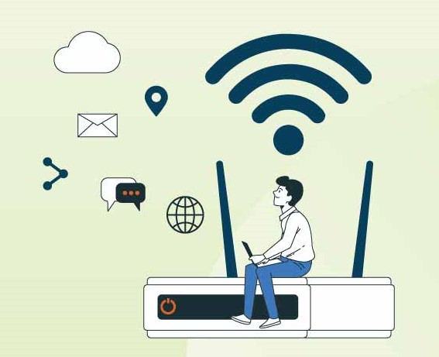
Objectives ●
Objectives
Create a deep learning model for material identification using WiFi signals
Integrate classical techniques (amplitude and phase) with advanced methods (spectrogram analysis)
Enhance signal clarity and reduce noise through advanced preprocessing techniques
Provide innovative, cost-effective, and privacy-preserving alternatives to visual-based sensing methods

Slide 7
Table Of Contents
Context
Objectives
SOTA
Proposed Solution
Results
Conclusions

Slide 8
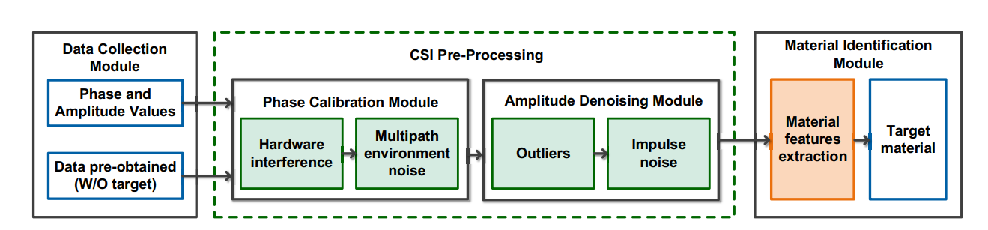
SOTA ●○○
WiMi
Approaches:
Amplitude and Phase sanitization
Material identification performed by classification algorithm
WiMi (2019, Feng et al.)

Slide 9
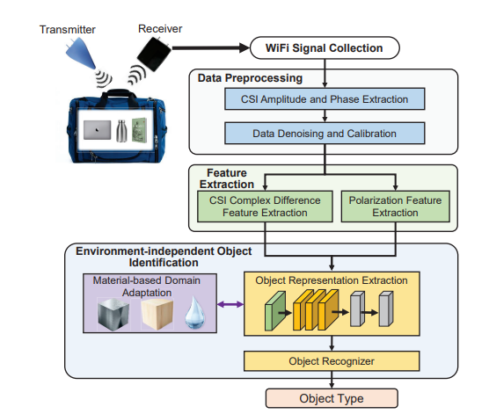
SOTA ○●○
In-Baggage Object Identification
Approaches:
Amplitude and Phase sanitization
Polarized WiFi
Material-Based Domain Adaptation
In-Baggage Object Identification
(2021, Shi et al.)

Slide 10
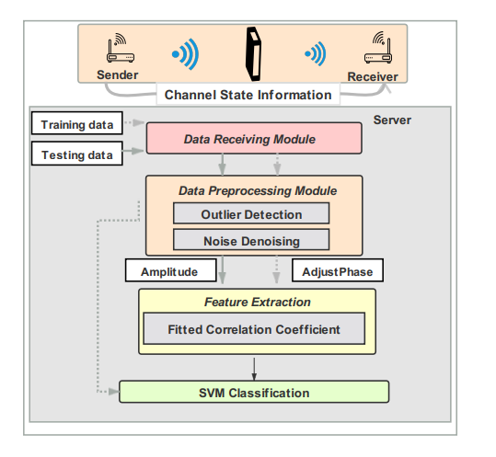
SOTA ○○●
WiMate
Approaches:
Amplitude and Phase sanitization
Fitted Correlation Coefficient
SVM for classification
WiMate (2021, Gu et al.)

Slide 11
Table Of Contents
Context
Objectives
SOTA
Proposed Solution
Results
Conclusions

Slide 12
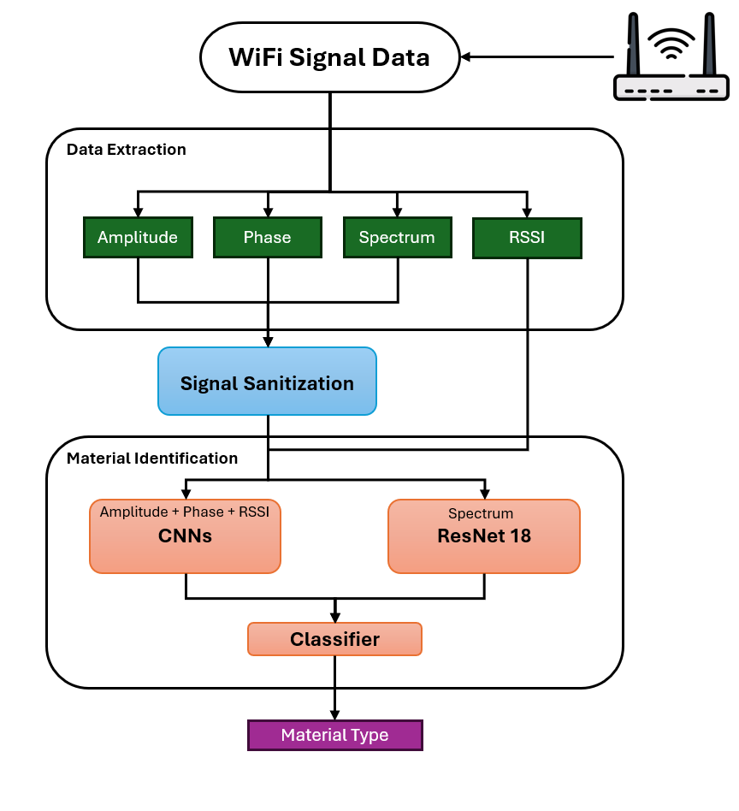
Proposed Solution ●○○
Workflow

Slide 13

Proposed Solution ○●○
Signal Sanitization
Amplitude outlier removal
Phase calibration
Spectrum sanitization
  Hann window
  Short Time Fourier Transform
  Normalization
  Interpolation 224x224

Slide 14
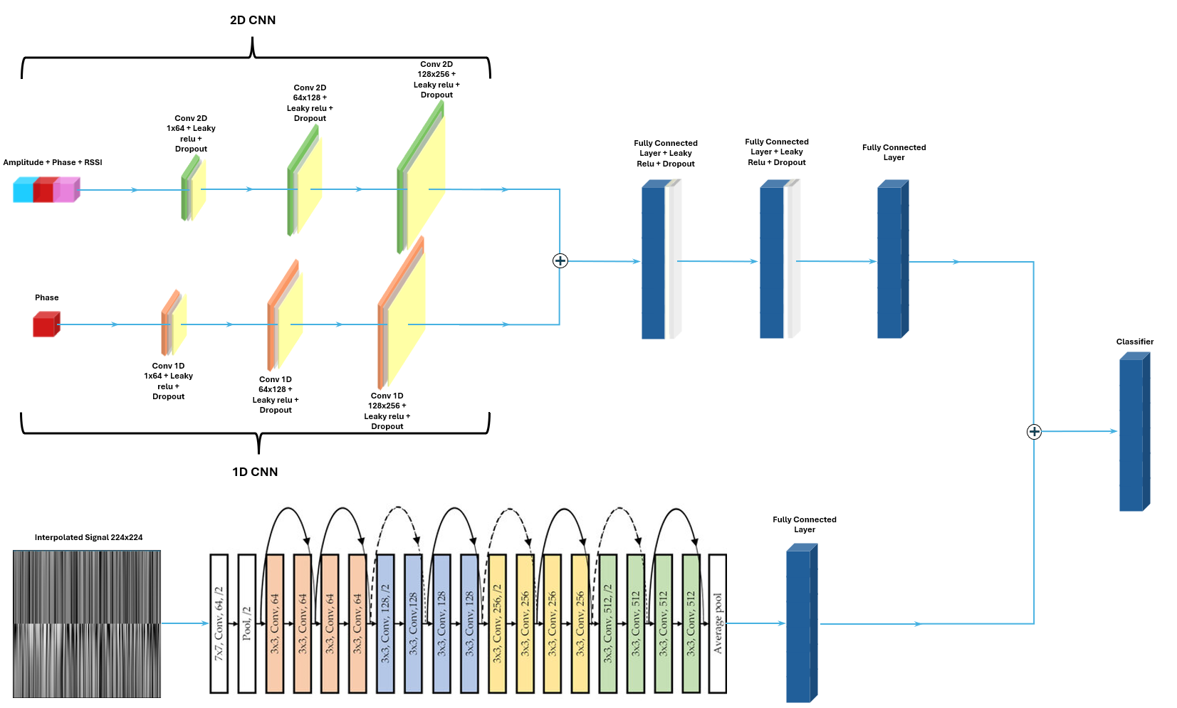
Proposed Solution ○○●
Architecture

Slide 15
Table Of Contents
Context
Objectives
SOTA
Proposed Solution
Results
Conclusions

Slide 16
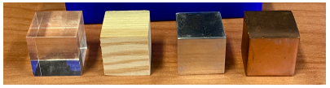
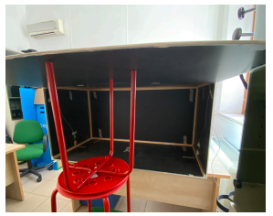
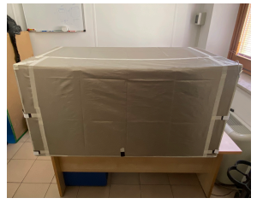
Results ●○○
Data Acquisition
13 different materials
Shielded and unshielded environment
10 tests for each class
260 total tests
Notes:
The clean EEG signals and noise signals are augmented adding random disturb
The EEG signals are partially reused to match the EMG and EOG signals
Data are divided in training, validation, and test sets
The noise signals are added to the EEG signals
The noisy EEG signals are normalized by dividing them by the standard deviation

Slide 17
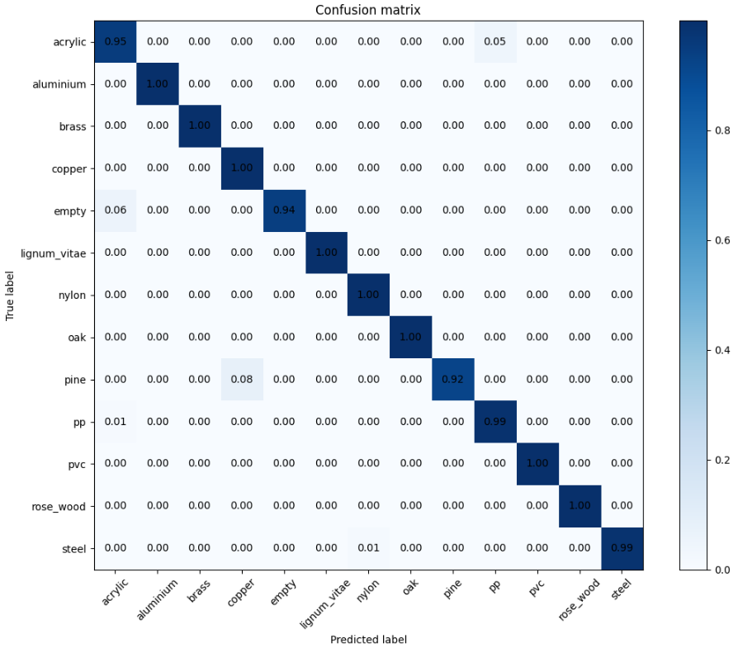
Results ○●○
Results

Slide 18
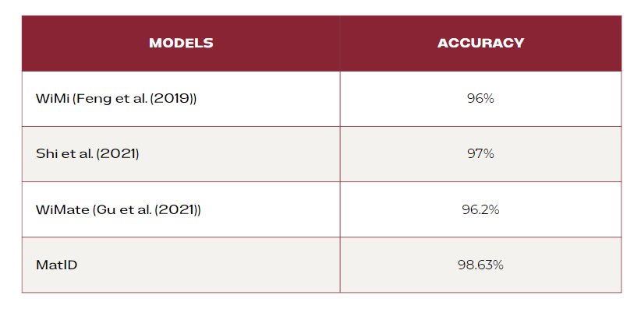
Results ○○●
Comparison

Slide 19
Table Of Contents
Context
Objectives
SOTA
Proposed Solution
Results
Conclusions

Slide 20
Conclusions ●
Conclusions and Future Improvements
This work shows that WiFi sensing is a viable alternative to traditional methods and how the combination of traditional spectrogram techniques for optimal results
Using a more diverse dataset
Using a more powerful hardware
More complex architecture and sanitization techniques
Perform material identification in different environments

Slide 21
From Signals to Sensing: MatID a Deep Learning Approach to WiFi-Based Material Identification
Thank you for listening!
Any questions?

